Slide 1
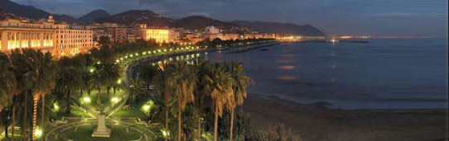
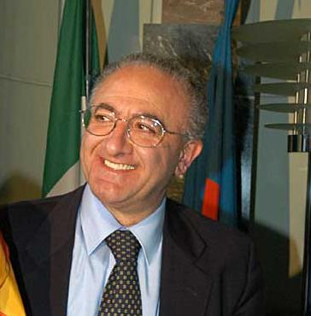
SustAinabLe EneRgy NOw
Salerno, Italy
Vincenzo Marano
Dept. of Industrial Engineering, University of Salerno, Italy, vmarano@unisa.it
Gianfranco Rizzo
Dept. of Industrial Engineering, University of Salerno, Italy, grizzo@unisa.it
Giancarlo Savino
Energy Manager, City of Salerno, Italy, g.savino@comune.salerno.it
Guangzhou Award for Urban Innovation, November 2012
Vincenzo De Luca
Mayor of Salerno

Slide 2
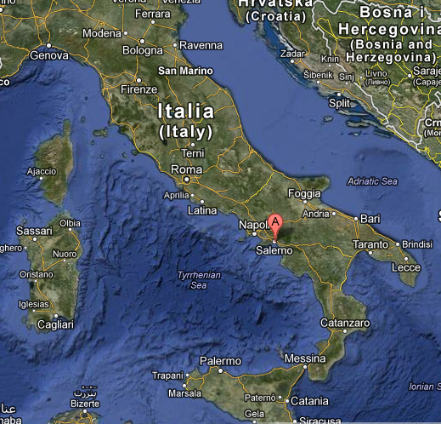
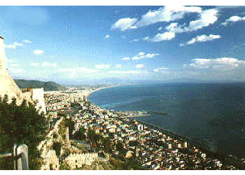
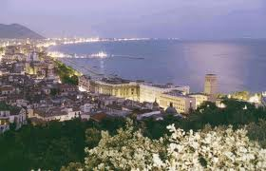
Salerno
Salerno is a city of about 150.000 inhabitants, in South Italy.
Salerno is located in a very attractive area, including many natural, archeological and cultural heritages.

Slide 3
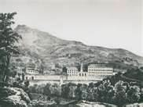
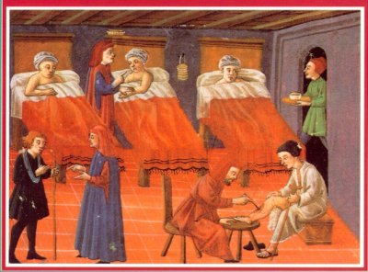

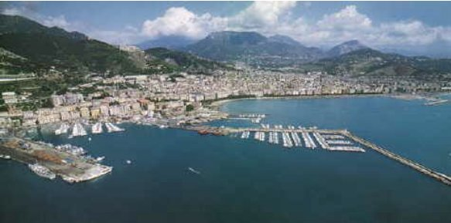
Salerno: history and economy
Salerno hosted one thousand years ago the most ancient medical school in Europe.
The city had a strong textile industry since ‘800s, and has now a large food industry and a very active seaport.

Slide 4
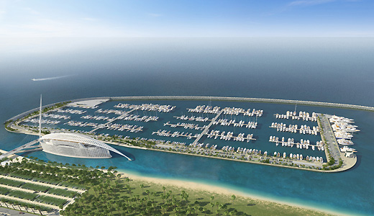
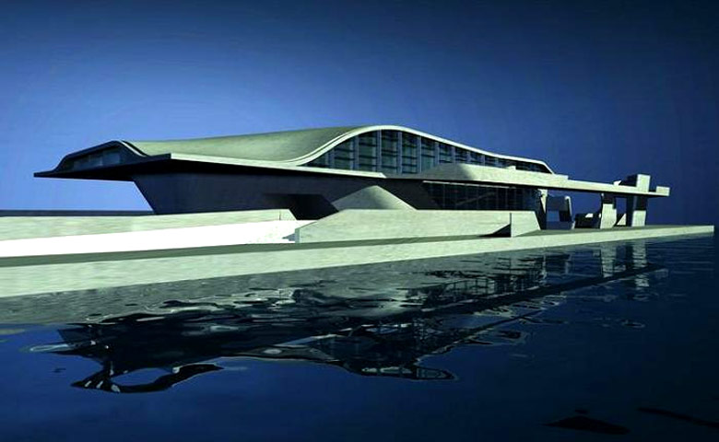

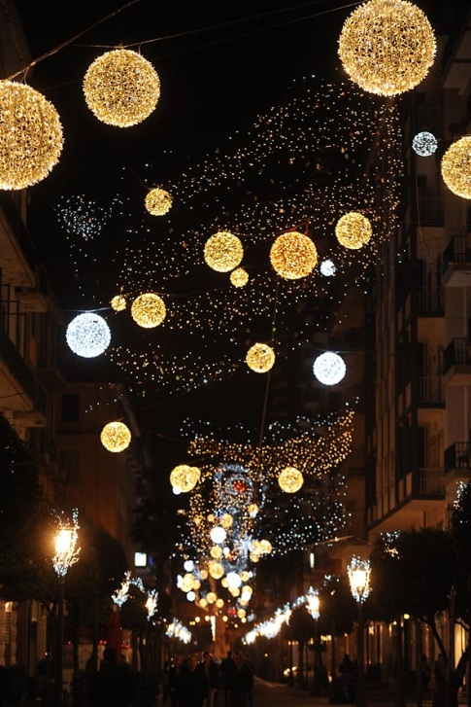
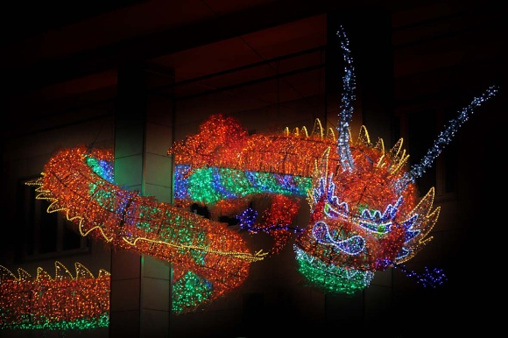

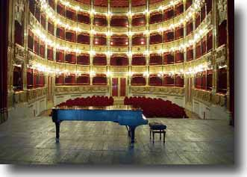
Great architecture and culture
Salerno is one of the most important cities in Europe for great contemporary architecture, with many operas designed by internationally recognized architects.
The city has a very active nightlife, many jazz musicians, and one of the best lyrical programming in Italy.

Slide 5
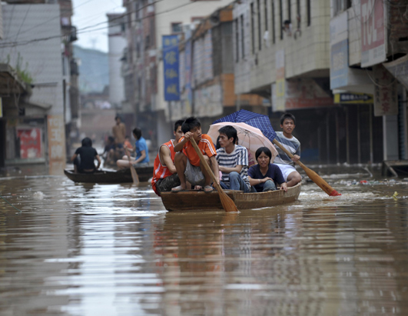
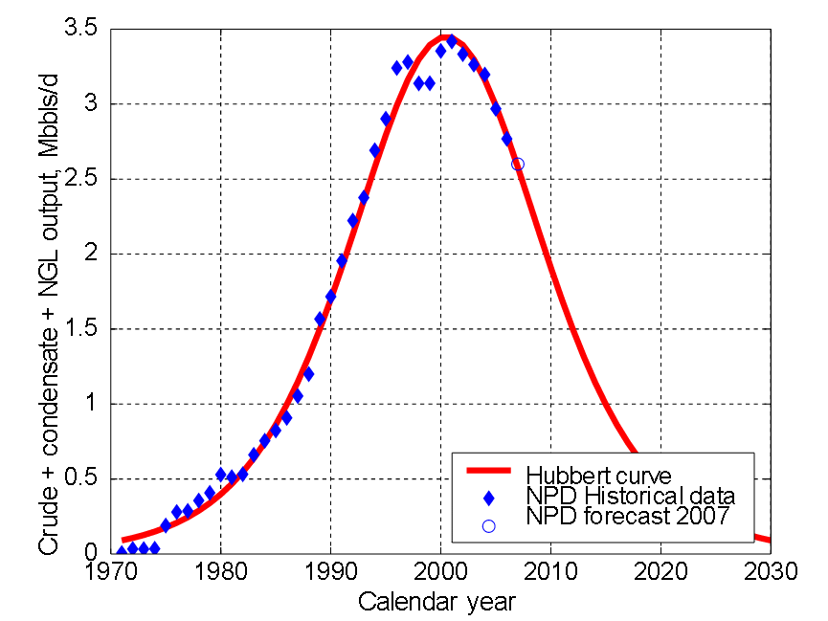
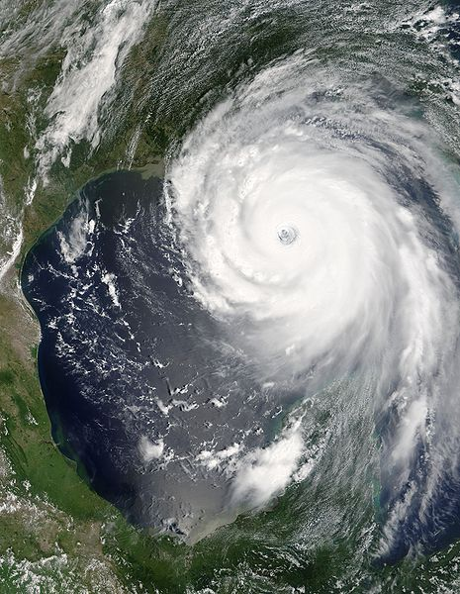
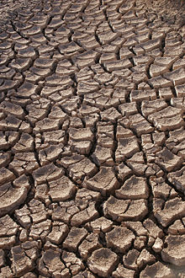
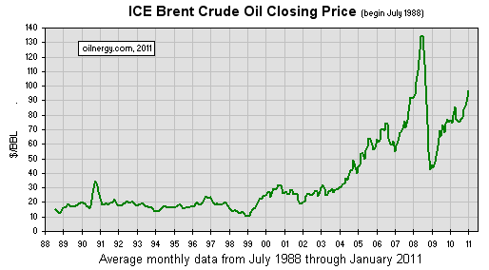
Salerno: between global challenges…
Fossil fuel depletion and
oil price growth and instabilities
Growing dryness, floods and hurricanes due to global warming

Slide 6
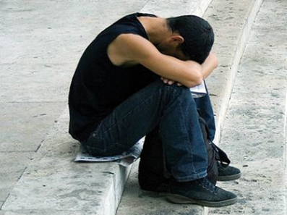
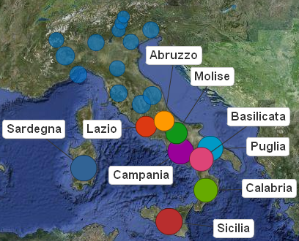
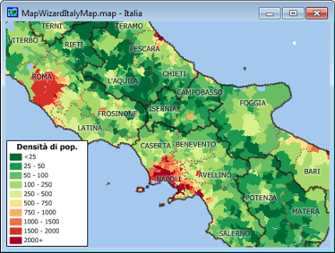
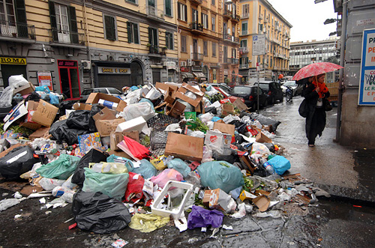
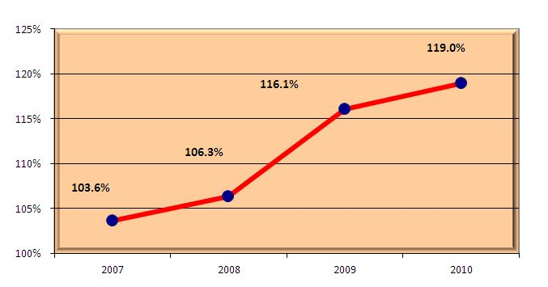
…local challenges,
Region with the highest density of population in Italy
Campania region has a high level of unemployment for young people
Italy: Debt-to-GDP ratio
Serious problems for waste disposal in Naples (only 50 km from Salerno)
Italy is facing a serious economic crisis, with a high level of national debt.

Slide 7
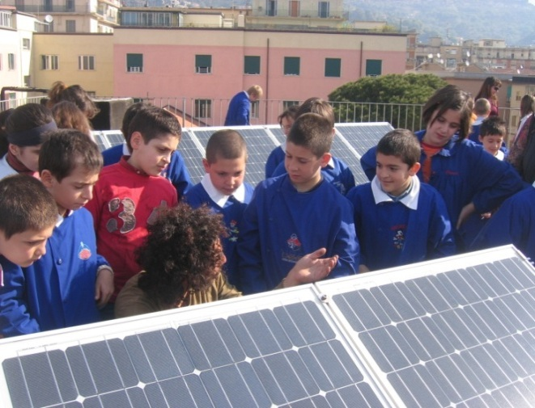
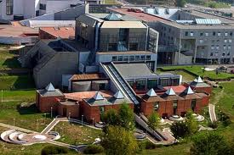

…and opportunities for change
The University of Salerno (40.000 students and ten faculties) is one of the most important in Italy, with a large and modern Campus.
Campania region has the highest birth rate in Italy, with many young people and students.
Salerno joined in 2010 the Covenant of Mayors, the European movement involving local and regional authorities, aiming to meet and exceed the European Union 20% CO₂ reduction by 2020 by an advanced Sustainable Energy Action Plan

Slide 8

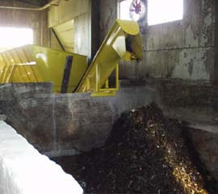
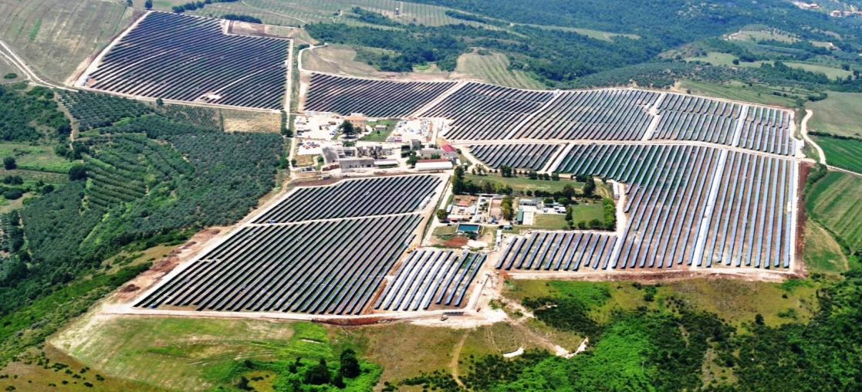
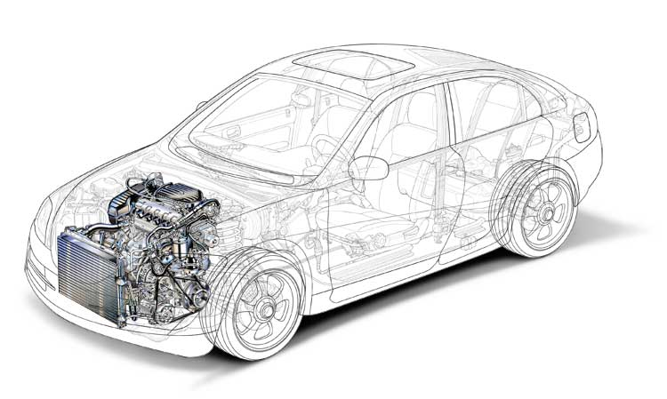
The solutions: City Energy Plan
A City Energy Plan has been developed, with many experts from university, awarded as the most advanced in Italy.
CO₂ (t/year)
567.000 t/year
70% rubbish and recycle
Composting plant
Energy and emission inventory
Kit for solar-hybridization of cars (20% less fuel consumption)
Photovoltaic plant 24 MWp

Slide 9
Sustainable Energy Action Plan: the actions
Action | Amount | Unit | Cost [M€] | CO2 % reduction
Thermal solar with seasonal storage | 2.000 | m2 | 1,8 | 0,11
PV on municipal building | 80 | kWp | 0,096 | 0,01
PV on schools and offices | 5.000 | kWp | 6 | 0,51
Public lighting optimization (flow regulators) | 22.500 | N. of lamps | 2,4 | 0,19
Cogeneration for swimming pool | 145 | kWe | 0,218 | 0,03
LED for traffic lights | 800 | N. of lamps | 0,142 | 0,01
Vertical wind turbines in the streets | 400 | N. of turbines | 4 | 0,03
Energy recovery from waterworks | 2.200 | MWh/year | 0,49 | 0,18
Electric cars with PV recharge | 50 | Veicolo+FV | 2,364 | 0,12
Electric buses with PV recharge | 30 | Veicolo+FV | 21,658 | 0,99
Public building energy optimization | 9.734 | MWh/year | 8,693 | 0,46
PV Monti di Eboli | 24.000 | kWp | 0 | 2,44
Cogeneration with biomass | 2.162 | kWe | 11,146 | 2,87
Insulating windows | 3.401 | mq | 1,02 | 2,53
PV Gazebo | 4.320 | kWp | 5,184 | 0,44
Green roofs | 164.800 | mq | 13,843 | 2,45
Subway | 25 | % trafic red. | 0 | 1,86
Differentiating waste and composting plant | 44.000 | t/year RD | 0 | 3,12
Car Pooling and traffic reduction | 15 | % trafic red. | 0 | 1,61
Wind plant Monti di Eboli | 20.000 | kW | 18 | 2,39
 |  |  | 97,053 | 22,34
Base CO₂: 576.000 t/year

Slide 10

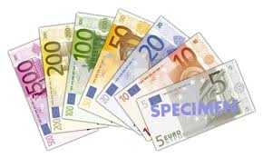
Difficulties, obstacles and solutions
The problems require a strong multidisciplinary approach
Cooperation of different specialists and experts from University
Privileged access to EU funds after approval of Sustainable Energy Action Plan
Difficulties to have credit from banks
Burocracy and political issues, due to different parties involved in local, regional and national government.
Information and activation of a front office for burocracy simplification

Slide 11
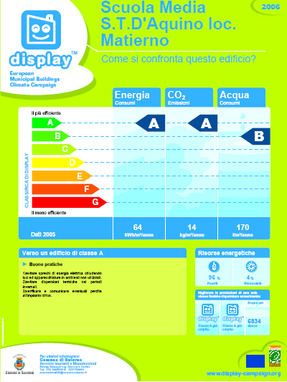

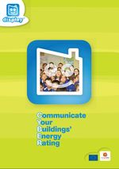
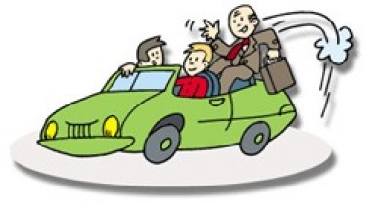
What could be replicated?
DISPLAY Campaign: monitoring energy and water consumption in the schools
Use of mathematical programming to set the priorities among different actions
CYBER
(Communicate Your Building Energy Rating)
Energy from municipal waterworks
Car Sharing
Car Pooling

Slide 12
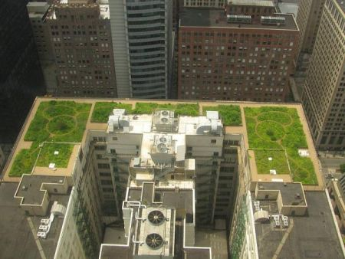

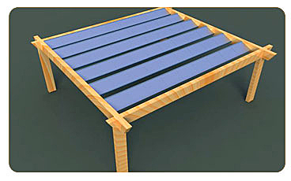
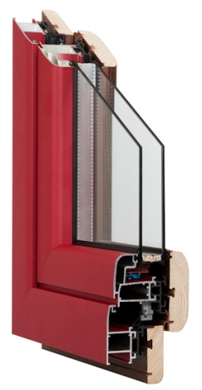
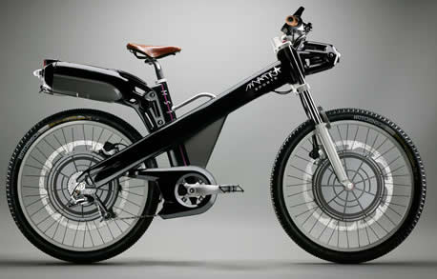
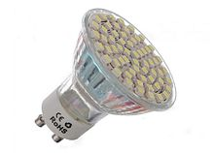
Solidarity Purchasing Groups
Green roofs to reduce heat losses, improve water retention, absorb CO2 and particulate.
Photovoltaic gazebo on building roofs
Organization of Solidarity Purchasing Groups to pool orders and stimulate private investments
Electric bikes
Insulating frames for windows
LED lamps

Slide 13

We do not inherit the Earth from our ancestors.
We borrow it from our children.
SustAinabLe EneRgy NOw
Thank you
谢谢

